Slide 1

Satyam Scandal
Background information
Nature- How scam executed, imported people involved
This Photo by Unknown Author is licensed under CC BY-NC

Slide 2

Background information on Inform Satyam Computer Services
1. Founding
Founded: 24 June 1987
Founder: B. Ramalinga Raju
Headquarters: Hyderabad, India
Nature of business: IT services, consulting, and outsourcing which focused on software development and gradually entered global markets through cost-effective outsourcing services.

Slide 3

2. Boom / Rise to Success
During the late 1990s and early 2000s, Satyam grew rapidly:
“By mid-2000s, Satyam became the 4th largest IT company in India, behind TCS, Infosys, and Wipro.”
It served around 600+ global clients, including Fortune 500 companies.
*Employee count crossed 50,000+ before the scandal.
*Satyam was viewed as a fast-growing global IT giant, often compared with India’s top tech companies.

Slide 4

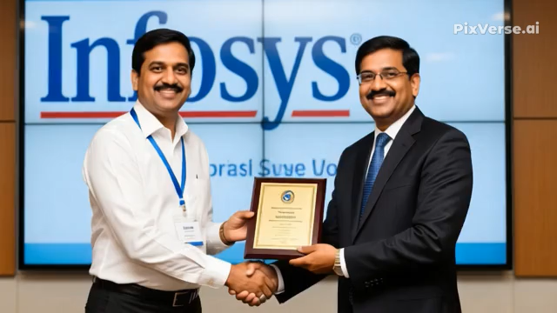
Feature Satyam Infosys
Founded 1987 1981
Founder B. Ramalinga Raju N. R. Narayana Murthy & team
Reputation Fast-growing, aggressive expansion Highly ethical, transparent, strong corporate governance
Financial Transparency Later found to be falsified Known for strict accounting standards
Outcome Collapsed in 2009 due to fraud Continued growing into a global IT leader
Main contrast: Infosys became famous for ethics and transparency, while Satyam became the biggest example of corporate fraud in India

Slide 5
Awards Received by Satyam (Before the Scandal)
Golden Peacock Award for Corporate Governance (2008)
(Ironically, this was later stripped after the scandal.)
Best Employer Awards from organizations like Hewitt Associates
Top IT Service Provider Rankings in surveys by CIO magazine
Awards for quality processes such as SEI-CMM Level 5 certifications
Asian Business Leadership Awards for its rapid growth
These awards helped create the illusion that Satyam was extremely stable, well-managed, and ethical — until the accounting fraud was exposed.

Slide 6

SATYAM SCAM – NATURE, HOW IT WAS EXECUTED, AND PEOPLE INVOLVED
The Satyam Computer Services Scam (2009) is known as India’s biggest
corporate accounting fraud. It was often called
“India’s Enron.”
1. Nature of the Scam
The scam was a corporate fraud involving:
Manipulation of financial statements
Inflating profits and revenues
Creating fake cash balances
Showing fake assets
Misleading shareholders, investors, employees, and government regulators
It was mainly an accounting scam and corporate governance failure.

Slide 7

2. How the Scam Was Executed (Step-by-Step)
Step 1: Inflating Company Profits
Fake sales invoices were created.
Company revenues were shown much higher than actual.
Profit margins were artificially increased every quarter.
Step 2: Creating Fake Bank Accounts
Fake bank statements were prepared.
Fake cash balances worth ₹5,040 crore were shown.
The company looked financially strong even though it wasn’t.
Step 3: Manipulation of Balance Sheets
Assets were inflated.
Liabilities were hidden.
False figures were inserted into accounts for many years.
Step 4: Misleading Auditors and Government Authorities
Fake documents were given to PricewaterhouseCoopers (PwC) auditors.
Auditors failed to verify whether the cash shown actually existed.
Step 5: Buying Family-Owned Companies
Raju tried to use Satyam’s money to buy his family companies (Maytas).
This step exposed the scam when shareholders opposed the deal

Slide 8
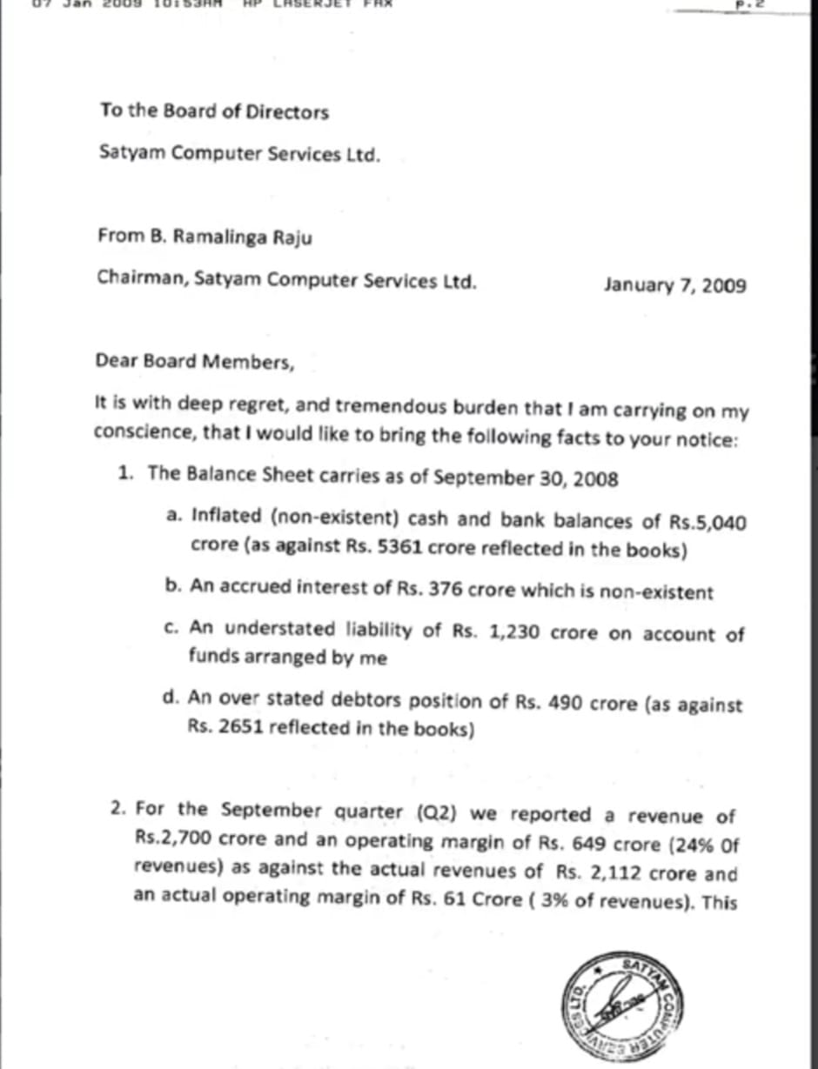
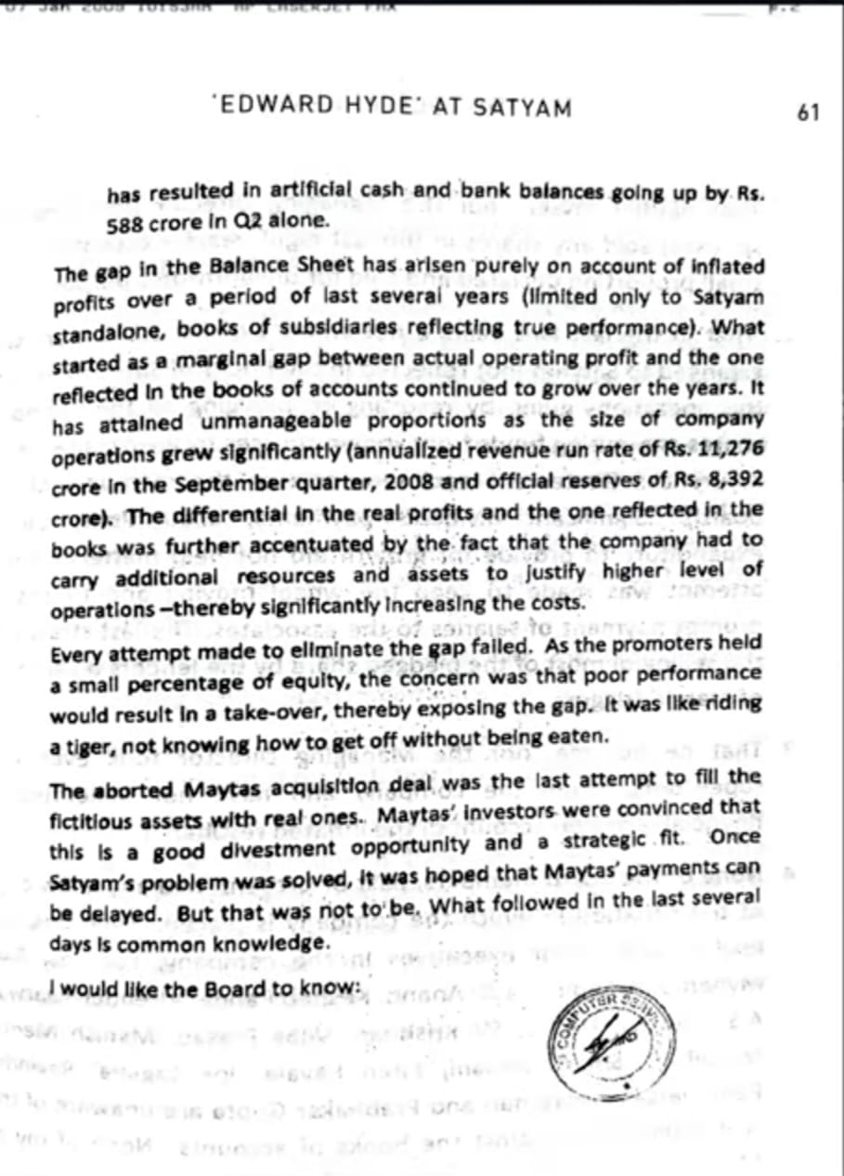
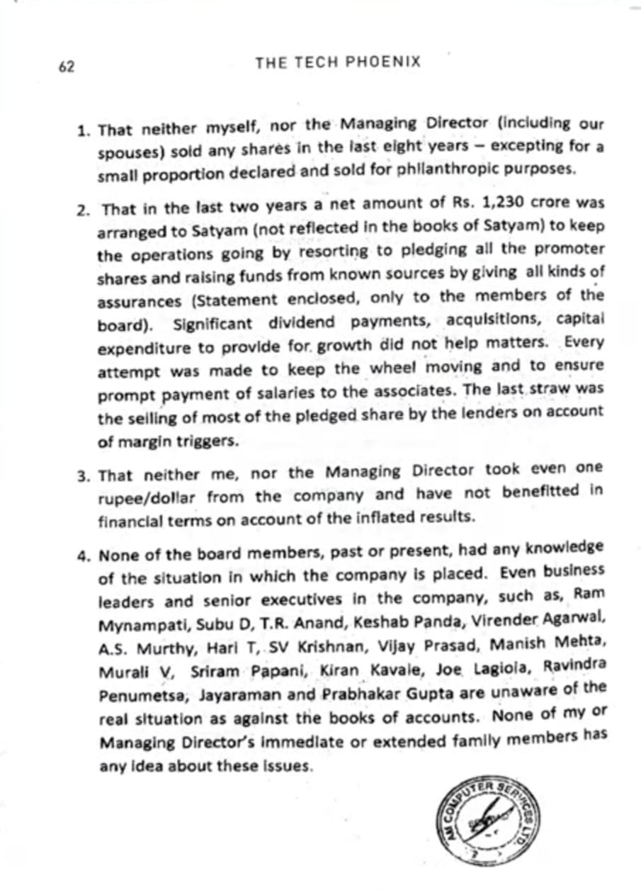
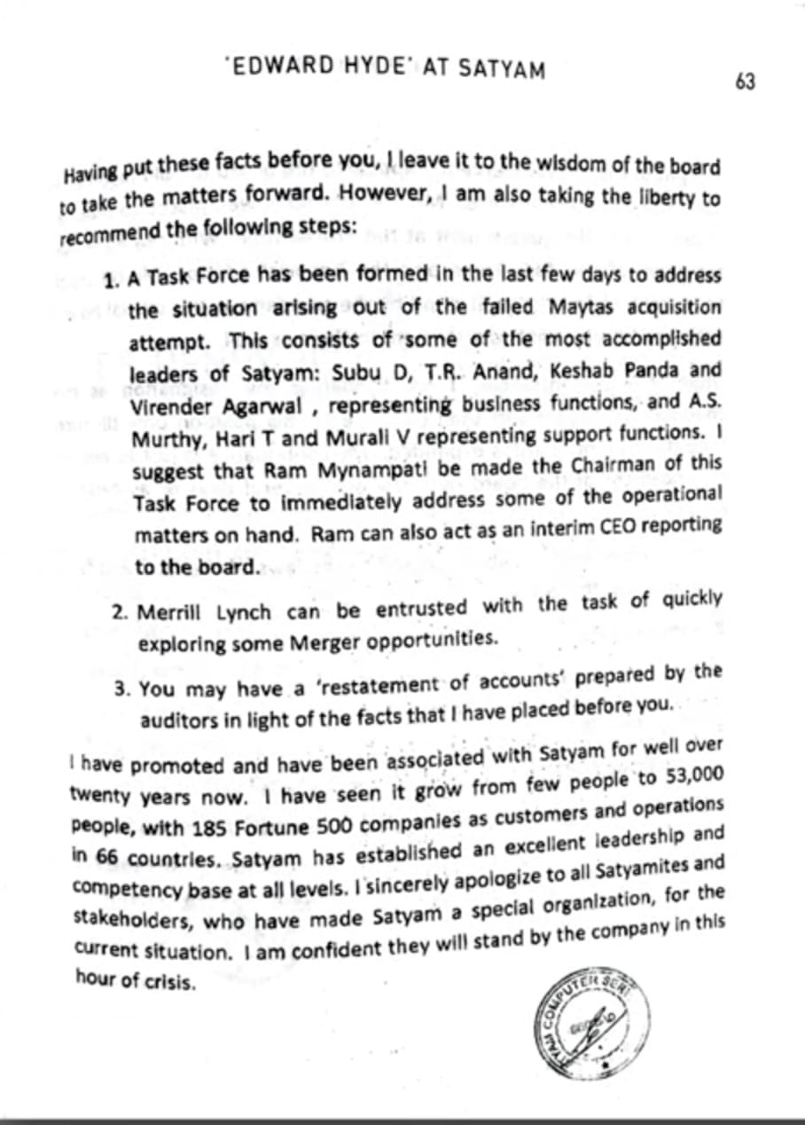
Confession:
On 7 January 2009,
Ramalinga Raju wrote a letter admitting all fraud.
He confessed that for years he had been showing false profits.

Slide 9

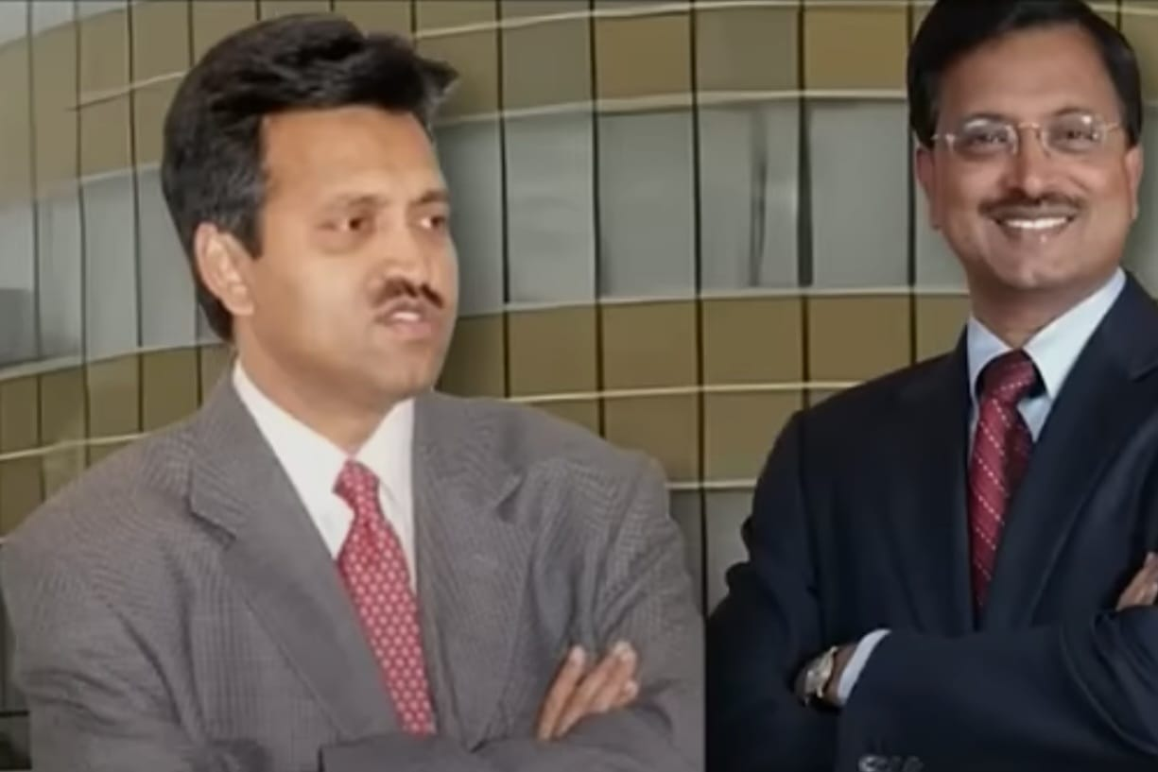
3. People Involved in the Scam
*1. B. Ramalinga Raju
Founder and Chairman of Satyam.
Mastermind of the entire scam.
Admitted manipulating accounts for years.
2. B. Rama Raju
Brother of Raju.
Managing Director (MD) of Satyam.
Helped execute financial
manipulations.
*3. Vadlamani Srinivas
Chief Financial Officer (CFO).
Handled false accounts, fake revenue entries, and manipulated financial statements.
4. PricewaterhouseCoopers (PwC) Auditors
External auditors responsible for verifying accounts.
Failed to detect fraud for almost 8 years.
Key audit partners:
S. Gopalakrishnan
T. Srinivas
5. Finance Department Staff
Employees who created fake invoices.
Helped maintain fake bank statements and entries.
6. Board of Directors (Indirect Involvement)
Failed to question or detect fraud.
Weak corporate governance allowed Raju to
manipulate information.

Slide 10
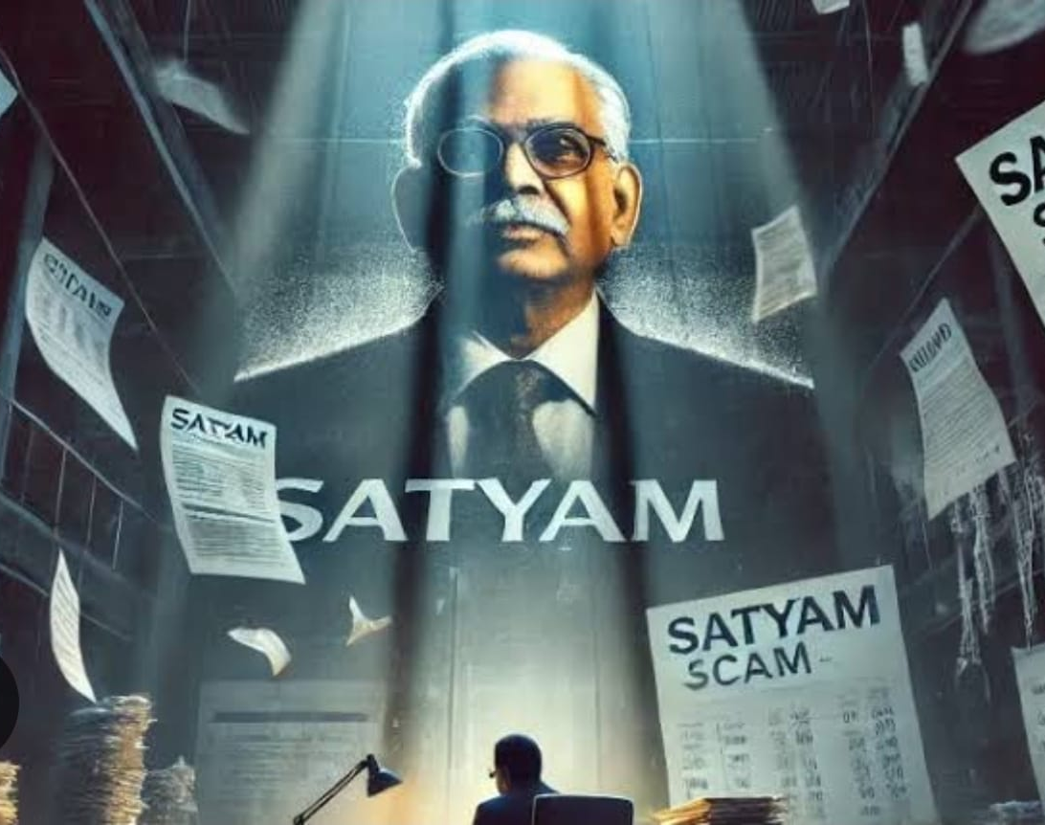
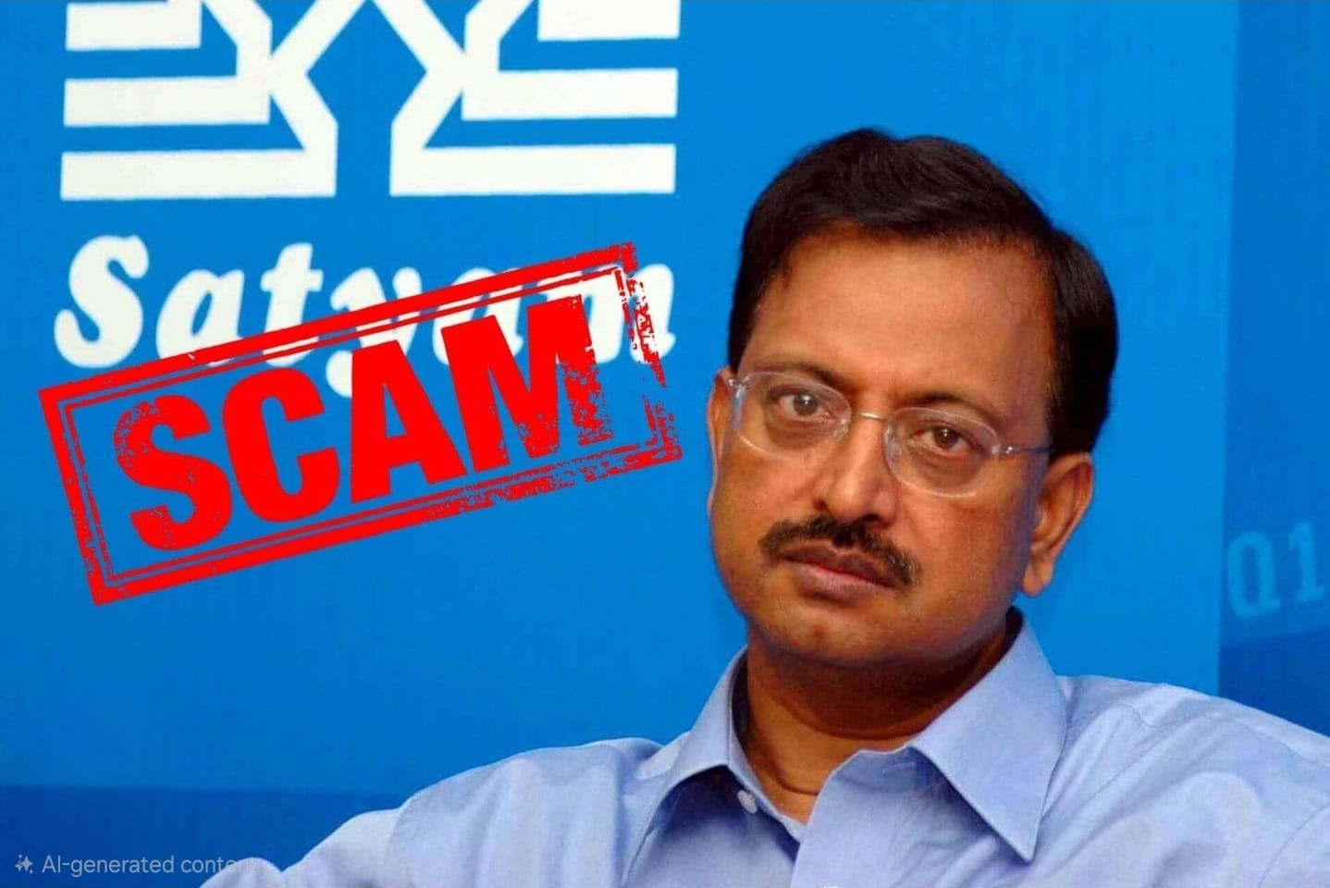

Summary
The Satyam scam was amajor accounting fraud where the company inflated profits, revenues, and cash balances using fake documents. The scam was executed by Chairman B.Ramalinga Raju along with top managing including his brother Rama Rjau, CFO Vadlamani Srinivas, and negligent auditors from PwC
WHY THE SCAM HAPPENED?!
Greed to attract investors
Maintain high stock prices
Pressure to show constant growth
Weak regulatory and audit controls

